Slide 1
MACHINE LEARNING
Water Usage
Prediction
Using Linear Regression | Machine Learning Project
NAME
ROLL NO
COURSE
S.Shashikanth
1601-24-771-130
Fundamentals of Machine Learning

Slide 2
Introduction
2
How does temperature affect water usage?
Goal
Predict water usage (liters) based on temperature (°C)
Applications
Benefits
Smart city water management
Municipal planning & budgeting
Shortage prevention
Early resource allocation
Data-driven decision making
Sustainable usage patterns

Slide 3
Dataset Overview
3
Dataset Features
Sample Data Preview
temperature_C | water_usage_liters
18.5 | 142.3
22.0 | 168.5
27.3 | 201.7
31.0 | 228.4
35.2 | 257.9
Column | Role | Type
temperature_C | Input Feature | Numeric (°C)
water_usage_liters | Target / Output | Numeric (L)
Source: CSV file loaded using pandas
Missing Values: None
Features: Single feature dataset
↑ Single-feature regression dataset

Slide 4
Model Used — Linear Regression
5
y=mx+b
Water Usage = (m * Temperature)+b
Simple & Interpretable
Fast Training
Easy to understand the relationship between variables
Works efficiently even with small datasets
Linear Relationship
Baseline Model
Fits well when temperature and usage are proportional
Excellent starting point before trying complex models

Slide 5
Model Training
6
# Python Code
.fit(X, y) → Trains the model on data
from sklearn.linear_model import
LinearRegression
model = LinearRegression()
model.fit(X,y)
Coefficients = model.coef_[0]
intercept = model.intercept_
coef_ → Slope (m) learned from data
intercept_ → Base value (b)

Slide 6
Multiple Linear Regression Equation
7
Water Usage = (Slope * Temperature) + Intercept
y = m₁x₁ + m₂x₂ + ... + mₙxₙ + b
COEFFICIENTS (m₁...mₙ)
INTERCEPT (b)
FEATURES (x₁...xₙ)
coef_[0..n]
intercept_
x₁, x₂ ... xₙ
Each coefficient shows the effect of one feature on the output
Base water usage at 0°C (constant offset)
Multiple input variables (e.g., temp, humidity, population)
e.g., m₁=5.8 for temp, m₂=3.2 for humidity
e.g., b = 40 → minimum baseline usage
Each xᵢ contributes independently to the prediction

Slide 7
Model Evaluation Metrics
8
R²
MSE
RMSE
R² Score
Mean Squared Error
Root Mean Squared Error
Measures how well predictions match actual values. Range: 0 to 1. Closer to 1 = better fit.
Penalizes large errors heavily. Measures the average squared difference between predicted and actual.
In the same units as the target variable (liters). Easier to interpret than MSE.
Target: > 0.85
Target: as low as possible
Target: as low as possible

Slide 8
Results
9
0.95
637.5
25.25
R² Score
MSE
RMSE
95% accuracy
Low squared error
~25 L avg error
✓ Model successfully predicts water usage from temperature
High R² score confirms strong linear relationship between features

Slide 9
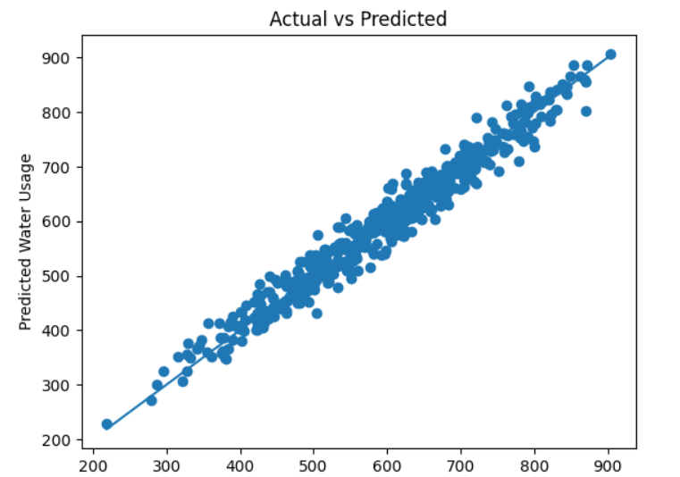
PREDICTIONS

Slide 10
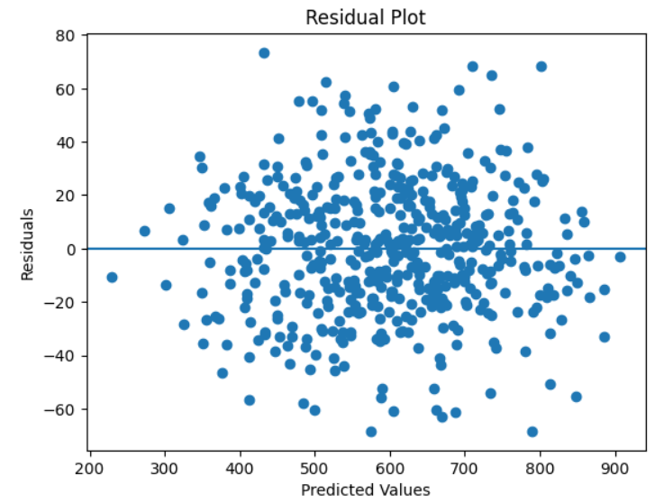
Residual Plot

Slide 11
Residual Analysis
12
Residual = Actual Value − Predicted Value
✓
Near Zero = Good
⟷
Random Spread = Better Fit
Residuals close to 0 mean the model predicts accurately with minimal error.
No systematic pattern in residuals means the model captured all trends.
↕
Large Values = Issues
⚖
Balanced +/−
Big residuals indicate the model is missing some pattern in the data.
Equal positive and negative residuals means no consistent over/under prediction.

Slide 12
Conclusion
✓
Linear Regression successfully models water usage from temperature
✓
Model is simple, fast, and highly interpretable for real-world use
✓
Achieved high R² score with low prediction errors (MSE/RMSE)
✓
Suitable baseline model for water resource management systems

Slide 13
Future Improvements
15
Add More Features
Try Advanced Models
Humidity (%)
Decision Tree
[Medium complexity]
High humidity reduces evaporation and may affect usage patterns
Captures non-linear splits & interactions
Population
Random Forest
[High accuracy]
Scale predictions by regional population density
Ensemble of trees with lower overfitting
Season / Month
Polynomial Regression
[Better non-linearity]
Capture seasonal demand fluctuations
Extends linear model with curved fit
Day of Week
Neural Network
[Very high accuracy]
Weekday vs weekend behavioral patterns
Deep learning for complex patterns

